Slide 1
Subnets
IP addressing can cause problems as networks grow. For example, consider a university that started out with one class B network used by the Computer Science Dept. for the computers on its Ethernet. The Electrical Engineering Dept. wanted to get on the Internet, so they bought a repeater to extend the CS Ethernet to their building.
As time went on, many other departments acquired computers and the limit of four repeaters per Ethernet was quickly reached.
A different organization was required. Getting a second network address would be hard to do since network addresses are scarce and the university already had enough addresses for over 60,000 hosts. The problem is the rule that a single class A, B, or C address refers to one network, not to a collection of LANs.
As more and more organizations ran into this situation, a small change was made to the addressing system to deal with it.The solution is to allow a network to be split into several parts for internal use but still act like a single network to the outside world.
Each of the Ethernets has its own router connected to the main router.

Slide 2
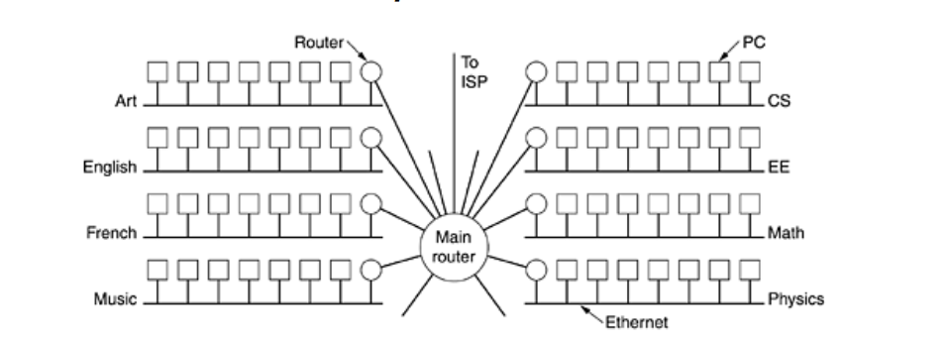
Subnets- Campus Network

Slide 3
Subnets
Subnetting: This involves dividing a larger network into smaller sub-networks.
For example, if you have a 192.168.1.0/24 network, you might subnet it into two smaller networks: 192.168.1.0/25 and 192.168.1.128/25. This helps in efficiently using IP addresses and managing network traffic.
Address Ranges: Each subnet has a range of IP addresses that can be assigned to devices.
For example, the subnet 192.168.1.0/25 has addresses ranging from 192.168.1.1 to 192.168.1.126, with 192.168.1.0 as the network address and 192.168.1.127 as the broadcast address.
Broadcast and Network Addresses:
Network Address: The first address in a subnet, used to identify the subnet itself (e.g., 192.168.1.0 for the subnet 192.168.1.0/24).
Broadcast Address: The last address in a subnet, used to send data to all devices within the subnet (e.g., 192.168.1.255 for the subnet 192.168.1.0/24).

Slide 4
Subnets
Benefits of Subnetting:
Improved Performance: Reducing broadcast domains to smaller segments can decrease network congestion.
Enhanced Security: Segmentation can help isolate sensitive parts of the network.
Efficient IP Address Management: Helps in utilizing IP addresses more effectively.
Suppose you have a network 10.0.0.0/24, and you want to create 4 subnets.
You would use a /26 mask (since 24 + 2 = 26) to get four subnets:
10.0.0.0/26 (Range: 10.0.0.1 to 10.0.0.62)
10.0.0.64/26 (Range: 10.0.0.65 to 10.0.0.126)
10.0.0.128/26 (Range: 10.0.0.129 to 10.0.0.190)
10.0.0.192/26 (Range: 10.0.0.193 to 10.0.0.254)

Slide 5
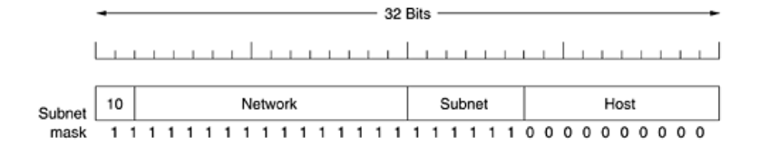
Subnets
To implement subnetting, the main router needs a subnet mask that indicates the split between network + subnet number and host, as shown in Figure.
Subnet masks are also written in dotted decimal notation, with the addition of a slash followed by the number of bits in the network + subnet part.
For the example in a figure the subnet mask can be written a s 255.255.252.0. An alternative notation is /22 to indicate that the subnet mask is 22 bits long.
The first subnet might use IP addresses starting at 130.50.4.1; the second subnet might start at 130.50.8.1; the third subnet might start at 130.50.12.1; and so on.

Slide 6

Subnets
To see why the subnets are counting by fours, note that the corresponding binary addresses are as follows :
Here the vertical bar (|) shows the boundary between the subnet number and the host number. To its left is the 6-bit subnet number; to its right is the 10-bit host number.
To see how subnets work, it is necessary to explain how IP packets are processed at a router. Each router has a table listing some number of (network, 0) IP addresses and some number of (this-network, host) IP addresses.
The first kind tells how to get to distant networks. The second kind tells how to get to local hosts. Associated with each table is the network interface to use to reach the destination, and certain other information.
When an IP packet arrives, its destination address is looked up in the routing table. If the packet is for a distant network, it is forwarded to the next router on the interface given in the table.
If it is a local host (e.g., on the router's LAN), it is sent directly to the destination. If the network is not present, the packet is forwarded to a default router with more extensive tables. This algorithm means that each router only has to keep track of other networks and local hosts, not (network, host) pairs, greatly reducing the size of the routing table.

Slide 7
Subnets
When subnetting is introduced, the routing tables are changed, adding entries of the form (this-network, subnet, 0) and (this-network, this-subnet, host). Thus, a router on subnet k knows how to get to all the other subnets and also how to get to all the hosts on subnet k.
It does not have to know the details about hosts on other subnets. In fact, all that needs to be changed is to have each router do a Boolean AND with the network's subnet mask to get rid of the host number and look up the resulting address in its tables.
For example, a packet addressed to 130.50.15.6 and arriving at the main router is ANDed with the subnet mask 255.255.252.0/22 to give the address 130.50.12.0.
This address is looked up in the routing tables to find out which output line to use to get to the router for subnet 3. Subnetting thus reduces router table space by creating a three-level hierarchy consisting of network, subnet, and host.

Slide 8
Classless Inter Domain Routing-CIDR
Classless Inter-Domain Routing, is a method for allocating IP addresses and routing IP packets. It was introduced to improve the scalability of routing and to address the limitations of the traditional classful addressing system.
Key Features of CIDR:
Flexible Subnetting: CIDR allows for variable-length subnet masking (VLSM), meaning you can create subnets of various sizes. This flexibility helps to use IP address space more efficiently compared to the fixed subnet sizes in the classful system.
CIDR Notation: CIDR uses a notation format of IP_address/Prefix_length, where Prefix_length indicates the number of bits used for the network portion of the address. For example, 192.168.1.0/24 means that the first 24 bits are used for the network address, and the remaining bits are used for host addresses.
Aggregation: CIDR enables route aggregation (also known as route summarization), where multiple IP addresses or subnets can be represented as a single, summarized route. This reduces the size of routing tables and improves routing efficiency. For example, if you have several subnets like 192.168.1.0/24 and 192.168.2.0/24, you could summarize these into a single route 192.168.0.0/24.
Efficient IP Address Utilization: By allowing subnet masks of various lengths, CIDR helps in minimizing wasted IP addresses. For instance, instead of using a fixed /24 subnet which might waste addresses if fewer hosts are needed, CIDR allows you to use a /26 or even smaller subnet if that fits your needs better.

Slide 9
Classless Inter Domain Routing-CIDR
How CIDR Works:
Network Portion: In CIDR notation, the / Prefix_length indicates how many bits are used for the network portion of the IP address. For example, 192.168.1.0/24 means the first 24 bits (the 192.168.1) are the network part, and the remaining 8 bits are for hosts.
Subnet Mask: The subnet mask corresponding to CIDR notation helps in determining the network and host parts of the IP address. For 192.168.1.0/24, the subnet mask is 255.255.255.0.
IP Range Calculation: To calculate the range of IP addresses within a subnet, you can use the network address and the subnet mask. For example, 192.168.1.0/27 has a subnet mask of 255.255.255.224, which means:
Network Address: 192.168.1.0
Usable IP Range: 192.168.1.1 to 192.168.1.30
Broadcast Address: 192.168.1.31

Slide 10
Classless Inter Domain Routing-CIDR
Examples of CIDR:
Small Subnet:
192.168.1.0/28
Subnet Mask: 255.255.255.240
IP Range: 192.168.1.1 to 192.168.1.14
14 usable IP addresses (minus network and broadcast addresses)
Larger Subnet:
10.0.0.0/22
Subnet Mask: 255.255.252.0
IP Range: 10.0.0.1 to 10.0.3.254
1022 usable IP addresses
Benefits of CIDR:
Reduces Wastage: By allowing subnetting with various lengths, CIDR reduces the waste of IP addresses.
Simplifies Routing: Aggregates multiple routes into a single route to minimize the size of routing tables.
Enhances Scalability: Improves the scalability of routing and addressing compared to classful addressing.

Slide 11
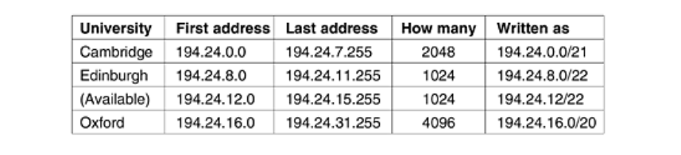
Classless Inter Domain Routing-CIDR
To make the forwarding algorithm easier to understand, let us consider an example in which millions of addresses are available starting at 194.24.0.0.
Suppose that Cambridge University needs 2048 addresses and is assigned the addresses 194.24.0.0 through 194.24.7.255, along with mask 255.255.248.0. Next, Oxford University asks for 4096 addresses. Since a block of 4096 addresses must lie on a 4096-byte boundary, they cannot be given addresses starting at 194.24.8.0.
Instead, they get 194.24.16.0 through 194.24.31.255 along with subnet mask 255.255.240.0. Now the University of Edinburgh asks for 1024 addresses and is assigned addresses 194.24.8.0 through 194.24.11.255 and mask 255.255.252.0. These assignments are summarized.

Slide 12
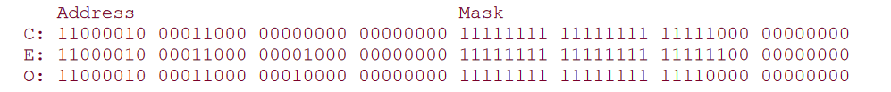
Classless Inter Domain Routing-CIDR
The routing tables all over the world are now updated with the three assigned entries. Each entry contains a base address and a subnet mask. These entries (in binary) are:
Consider what happens when a packet comes in addressed to 194.24.17.4, which in binary is represented as the following 32-bit string :
11000010 00011000 00010001 00000100
First it is Boolean ANDed with the Cambridge mask to get
11000010 00011000 00010000 00000000
This value does not match the Cambridge base address, so the original address is next ANDed
with the Edinburgh mask to get
11000010 00011000 00010000 00000000
This value does not match the Edinburgh base address, so Oxford is tried next, yielding
11000010 00011000 00010000 00000000

Slide 13
Classless Inter Domain Routing-CIDR
Allocated the IP address range 192.168.10.0/24 and need to divide it into smaller subnets for different departments in your organization. Each department needs a different number of IP addresses. You decide to create the following subnets:
Subnet A: 50 IP addresses
Subnet B: 30 IP addresses
Subnet C: 10 IP addresses
Steps to Subnet Using CIDR:
Determine Subnet Sizes
Subnet A: Needs 50 IP addresses.
To accommodate 50 IP addresses, you need a subnet that provides at least 64 addresses (since 2^6 = 64). Thus, a /26 subnet mask is needed (because 32 - 6 = 26).
Subnet B: Needs 30 IP addresses.
To accommodate 30 IP addresses, you need a subnet that provides at least 32 addresses (since 2^5 = 32). Thus, a /27 subnet mask is needed (because 32 - 5 = 27).

Slide 14
Classless Inter Domain Routing-CIDR
Subnet C: Needs 10 IP addresses.
To accommodate 10 IP addresses, you need a subnet that provides at least 16 addresses (since 2^4 = 16). Thus, a /28 subnet mask is needed (because 32 - 4 = 28).
Create Subnets
Start with 192.168.10.0/24:
Subnet A:
CIDR Notation: 192.168.10.0/26
Subnet Mask: 255.255.255.192
Network Address: 192.168.10.0
IP Range: 192.168.10.1 to 192.168.10.62
Broadcast Address: 192.168.10.63
Subnet B:
CIDR Notation: 192.168.10.64/27
Subnet Mask: 255.255.255.224
Network Address: 192.168.10.64
IP Range: 192.168.10.65 to 192.168.10.94
Broadcast Address: 192.168.10.95

Slide 15
Classless Inter Domain Routing-CIDR
Subnet C:
CIDR Notation: 192.168.10.96/28
Subnet Mask: 255.255.255.240
Network Address: 192.168.10.96
IP Range: 192.168.10.97 to 192.168.10.110
Broadcast Address: 192.168.10.111
Remaining Addresses
After allocating for Subnet A, B, and C, the remaining IP addresses in 192.168.10.0/24 would be:
Starting from 192.168.10.112/28 (using /28 for simplicity):
CIDR Notation: 192.168.10.112/28
Subnet Mask: 255.255.255.240
Network Address: 192.168.10.112
IP Range: 192.168.10.113 to 192.168.10.126
Broadcast Address: 192.168.10.127

Slide 16
Classless Inter Domain Routing-CIDR
Summary of Subnets:
Subnet A: 192.168.10.0/26
Network Address: 192.168.10.0
IP Range: 192.168.10.1 to 192.168.10.62
Broadcast Address: 192.168.10.63
Subnet B: 192.168.10.64/27
Network Address: 192.168.10.64
IP Range: 192.168.10.65 to 192.168.10.94
Broadcast Address: 192.168.10.95
Subnet C: 192.168.10.96/28
Network Address: 192.168.10.96
IP Range: 192.168.10.97 to 192.168.10.110
Broadcast Address: 192.168.10.111
Remaining Subnet: 192.168.10.112/28
Network Address: 192.168.10.112
IP Range: 192.168.10.113 to 192.168.10.126
Broadcast Address: 192.168.10.127

